Slide 1

Data Analysis Overview
NURS 6075 Statistics for Informatics
Christopher I. Macintosh, PhD, RN

Slide 2

Statistics Help Answer Questions

Slide 3

Statistics Provide Supporting Evidence

Slide 4

Statistics Should Be Valid

Slide 5
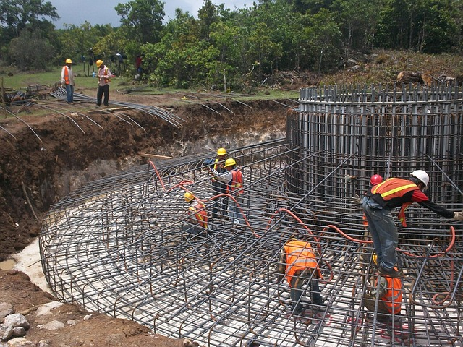

Statistics Build Upon A Foundation

Slide 6

Statistics Should Be Ethical

Slide 7
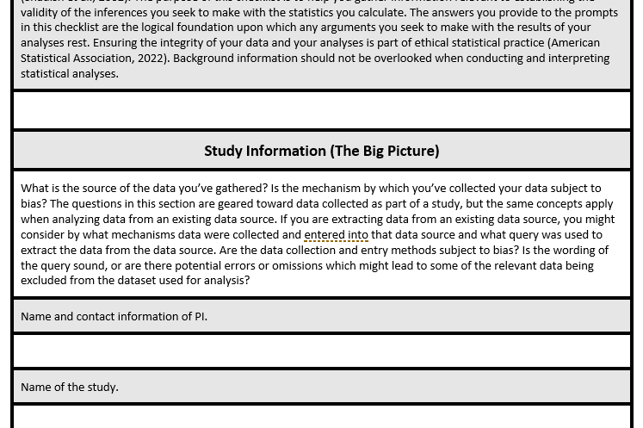
The Checklist

Slide 8



3 Main Parts
Study Information
Dataset Information
Test Information

Slide 9
Study Information
Overall details about the study
Name
Purpose
Research questions (& hypotheses)
Study design
Ethics information
Data collection
Data handling

Slide 10
Dataset Information
Variables
Data accuracy (& corrections)
Missing data (& corrections)
Outliers (& corrections)

Slide 11
Statistical Test Information
Test
Assumption checks (& corrections)
NHST steps
State the null & alternative hypotheses
Set criteria for rejection
Calculate test statistic
Draw conclusions about the null
Conduct post-hoc analyses
Report results

Slide 12
References
American Statistical Association. (2022, February 1, 2022). Ethical guidelines for statistical practice. Retrieved October 10 from https://www.amstat.org/your-career/ethical-guidelines-for-statistical-practice
Booth, W. C., Colomb, G. G., Williams, J. M., Bizup, J., & Fitzgerald, W. T. (2016). The craft of research (Fourth ed.). University of Chicago Press. https://doi.org/10.7208/chicago/9780226239873.001.0001
Field, A. (2018). Discovering statistics using IBM SPSS statistics (Fifth ed.). SAGE Publications, Inc.
Shadish, W. R., Cook, T. D., & Campbell, D. T. (2002). Experimental and quasi-experimental designs for generalized causal inference. Wadsworth, Cengage Learning.
Tabachnick, B. G., & Fidell, L. S. (2019). Using multivariate statistics (Seventh ed.). Pearson Education, Inc.

